Slide 1
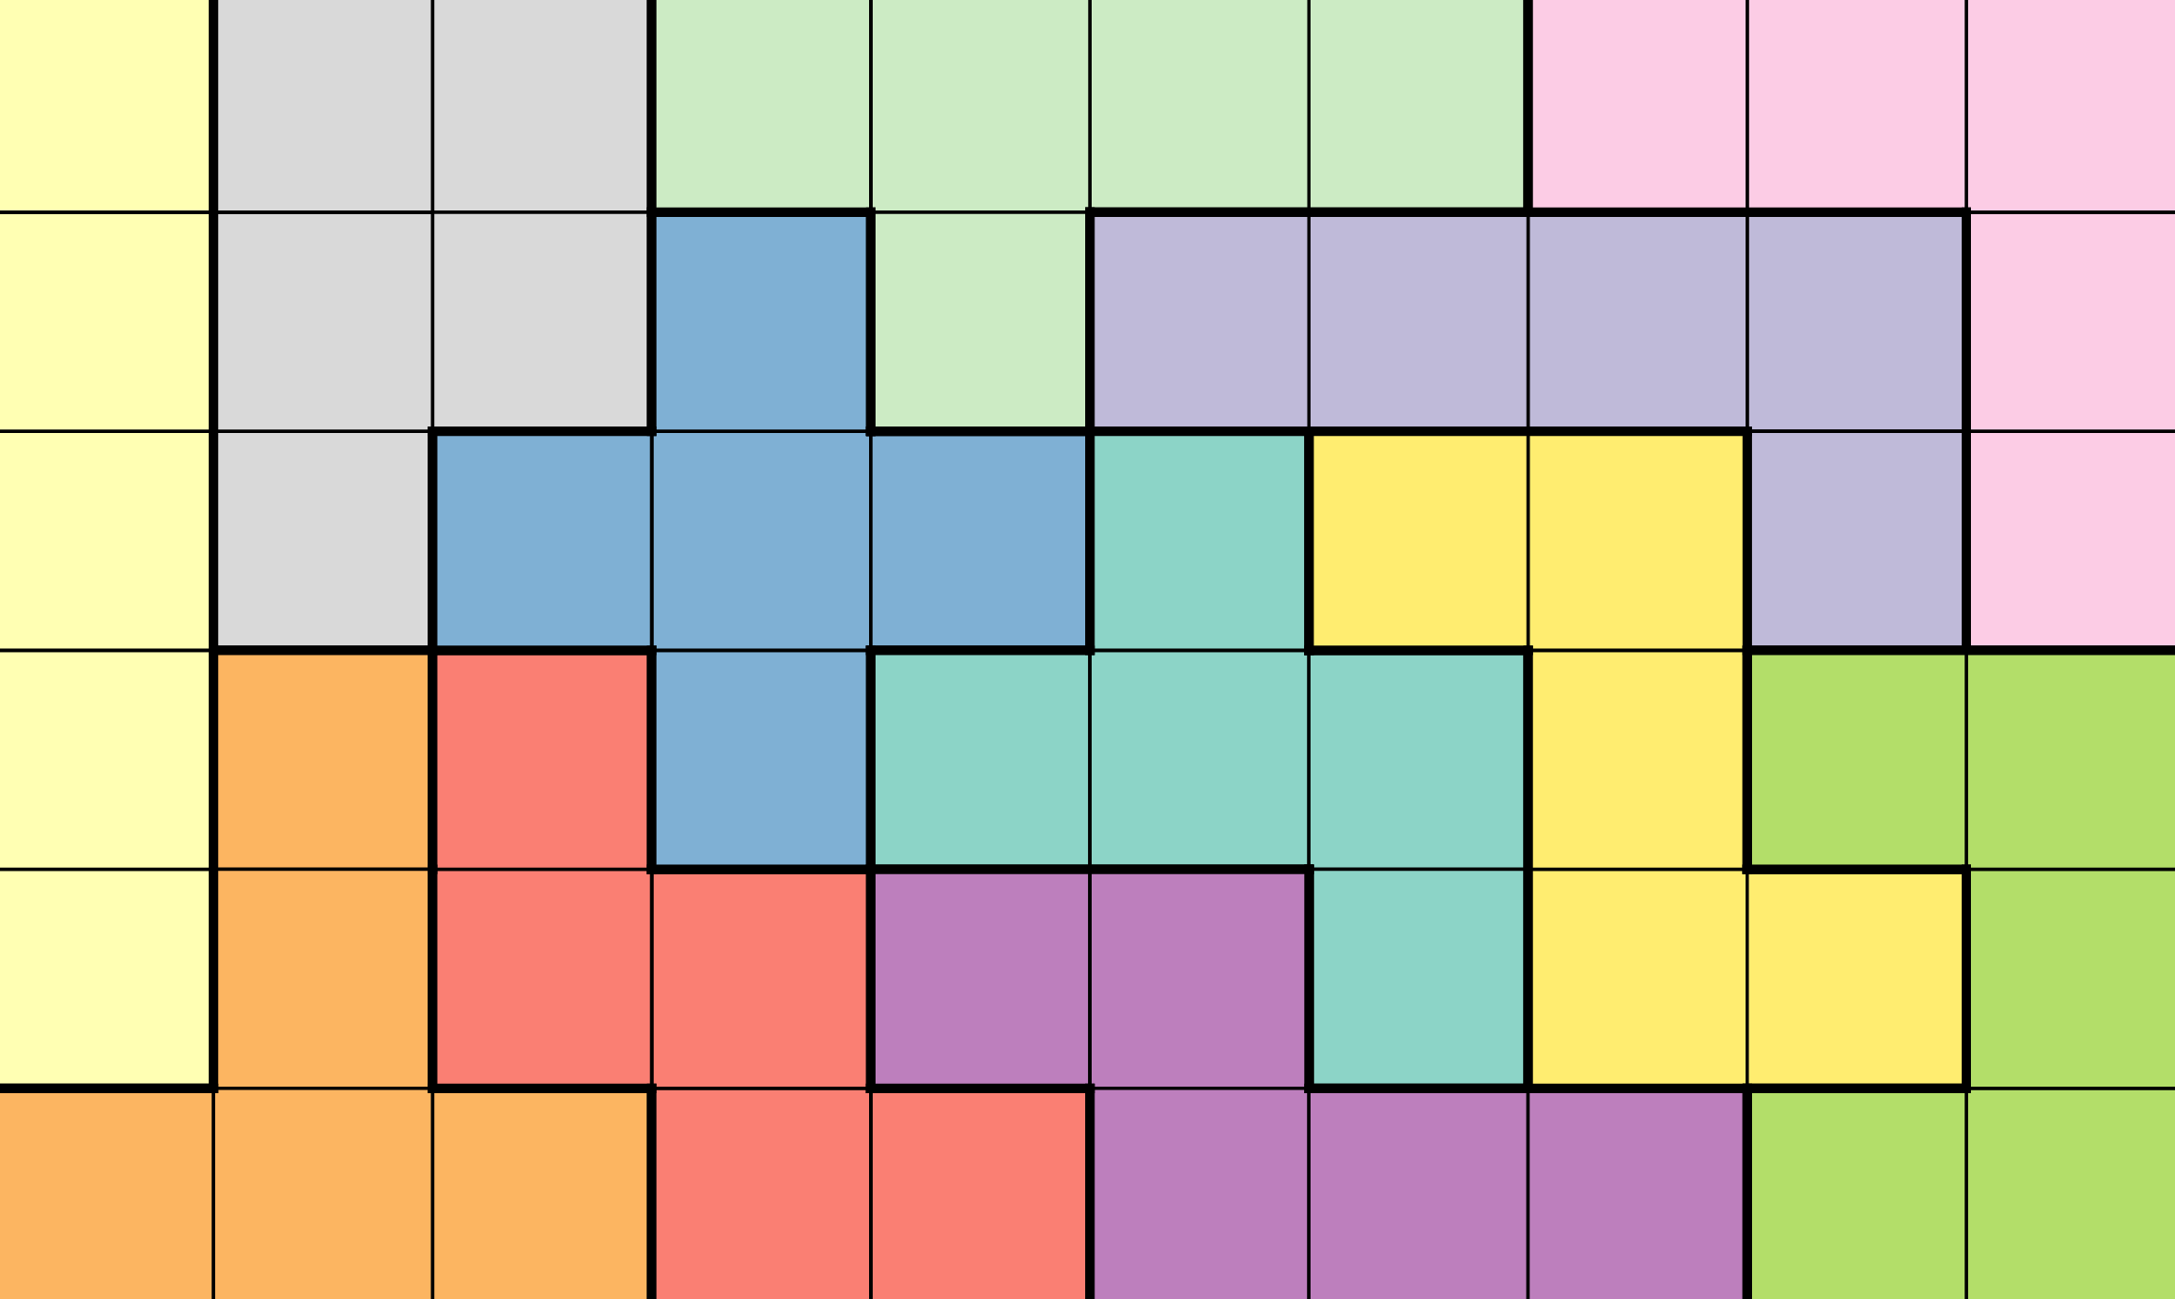
Online Polycube Packing with Deep Reinforcement Learning
Thomas Vroom
Notes:
Hello, my name is Thomas, and I am going to talk about my thesis, which is about "Online Polycube Packing with Deep Reinforcement Learning"

Slide 2
Content
Introduction & Motivation
Research Questions
Methods
Experiments & Results
Conclusion
Notes:
I am first going to introduce the problem and talk about the motivation behind researching it. I am then going to go through the research questions, the methods used, the experiments and results, and finally we'll end with a conclusion.

Slide 3
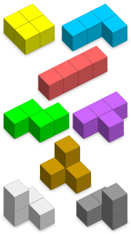
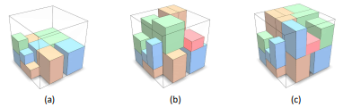

Introduction – Polycube Packing
Packing Problems
Regular Shapes
Irregular Shapes
Polycubes
Notes:
First of all, let's introduce the problem: online polycube packing is part of the general family of packing problems. These are optimization problems where the goal is to pack as many items as possible into a container with a fixed capacity. The most studied problem in this category is that of 3D packing problems, where items are given as either regular 3D shapes such as cubes, or irregular 3D shapes such as full 3D models. The polycube packing problems uses, as the name suggests, polycubes as items. Polycubes are connected sets of unit cubes in three-dimensional space. Complexity-wise, they lay somewhere in between regular and irregular shapes, which makes packing polycubes an interesting problem to study.

Slide 4
Introduction – Online Packing
Get Polycubes Sequentially
Heuristics vs. Learning
Restricting the Action Space
Notes:
Now, an online problem means that instead of just getting a set of polycubes and finding the optimal packing, we get the polycubes one by one, and have to make decisions without knowing which polycube comes next. Traditionally, online problems have been solved using heuristics, but more recently learning-based approaches like deep reinforcement learning have been shown to perform better in a range of problems. Deep reinforcement learning has been shown to work very well for packing regular shapes, but standard reinforcement learning algorithms struggle a lot with packing irregular shapes, due to the increased complexity of the problem. The solution to this has been to restrict the action space of the learning algorithm using heuristics, narrowing the possible actions down to only the most promising ones.

Slide 5
Research Questions
Can online polycube packing be solved using deep reinforcement learning?
How does the performance of deep reinforcement learning compare to traditional heuristics?
Can the performance of deep reinforcement learning be improved by using heuristics to restrict the action space?
Notes:
The research questions are as follows:
First of all, can online polycube packing be solved using deep reinforcement learning?
Next, how does the performance of deep reinforcement learning compare to traditional heuristics?
And finally, can the performance of deep reinforcement learning be improved by using heuristics to restrict the action space?

Slide 6
Methods – Markov Decision Process
States: container + polycube
Actions: position + orientation
Transition Probability Function: stochastic
Reward Function: number of polycubes packed
Notes:
Before we talk more about deep reinforcement learning, I think it would be helpful to first describe the online polycube packing problem as a Markov Decision Process, as that will help us understand what a reinforcement learning agent would actually look like for this problem. A Markov Decision Process consists of the following elements:
First of all: the set of states. We can define a state for our problem as a tuple of the current container, and the current polycube to be packed.
Next is the set of actions. An action in this context is a tuple consisting of a position inside the container where the polycube would be placed, together with the orientation of the polycube.
After that comes the transition probability function, but since the next polycube to be packed is not known beforehand, this function is fully stochastic, and thus irrelevant to our problem.
Finally, we have the reward function. This is equal to the number of polycubes packed at the end of the episode, as that is the metric that we want to optimize.

Slide 7
Methods – Deep Reinforcement Learning
Large State and Action Space
Stochastic Environment
Proximal Policy Optimization (PPO)
On-Policy, Model-Free
Interact with Environment
Update Policy
Stochastic Gradient Ascent
Notes:
Now, since we are dealing with quite a large state and action space in a stochastic environment, we restrict our choice of deep reinforcement learning algorithm to on-policy, model-free algorithms. One of the most popular algorithms in this category is Proximal Policy Optimization, PPO for short. PPO roughly works by interacting with the environment in batches, and then updating its policy using stochastic gradient ascent at the end of each batch. PPO outperforms most other policy gradient methods in a range of environments, and is known for its balance between sample efficiency, complexity and ease of use.

Slide 8
Experiments
PPO vs. Greedy with Heuristics
Container Sizes: 3x3x3, 5x3x3, 4x4x4, 6x4x4
PPO-D
Default Hyperparameters
PPO-O
Optimized Hyperparameters
PPO-H
Restricted Action Space
Notes:
For the experiments, we will be benchmarking three different PPO agents against a greedy agent that uses an optimal combination of packing heuristics. The three PPO agents are:
PPO-D: a PPO agent that uses the default hyperparameters, as provided by the original paper.
PPO-O: a PPO agent that uses optimized hyperparameters, tuned on a small container.
PPO-H: a PPO agent that uses optimized hyperparameters, as well as heuristics to restrict the action space during training.
Because training and evaluating all of these agents is very computationally expensive, the experiments were only performed on 4 different container sizes, which you can see here at the bottom.

Slide 9
Experiment 1
Training PPO Agents
Fixed number of steps
Until convergence
Mean Reward
Entropy Loss
Notes:
The first experiment is related to training the different PPO agents. All agents are trained for a fixed number of steps, where each step corresponds to a single polycube being placed. The agents are trained until convergence, which is determined by monitoring the step-by-step mean reward, which tells us how well the agent is performing, and the entropy loss, which tells us how much the agent is still exploring.

Slide 10
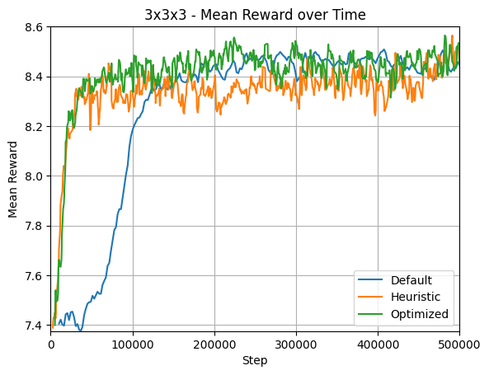
PPO-D
Default Hyperparameters
PPO-O
Optimized Hyperparameters
PPO-H
Restricted Action Space
Notes:
Let's first take a look at the mean reward over time on a 3x3x3 container. Here you can see PPO-D in blue, PPO-O in green and PPO-H in orange, And as you can see they all converge to the same mean reward, but PPO-D is the slowest to converge. Inherently it makes sense that PPO-H is able to converge faster than PPO-D, as restricting the action space to only the most promising actions should be faster than having to learn those promising actions from scratch, but what is interesting is that PPO-O is able to match the convergence rate of PPO-H.

Slide 11
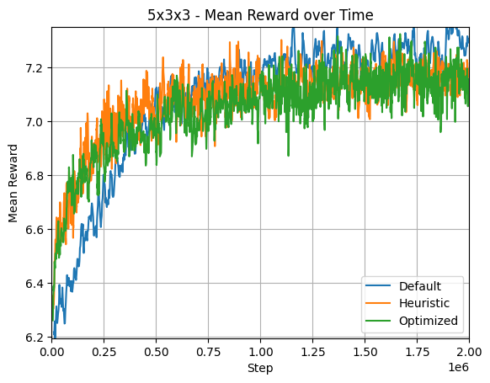
PPO-D
Default Hyperparameters
PPO-O
Optimized Hyperparameters
PPO-H
Restricted Action Space
Notes:
The same thing can be seen when we look at the mean reward for the 5x3x3 container. This suggests that restricting the action space using heuristics is not as successful here as with packing irregular shapes.

Slide 12
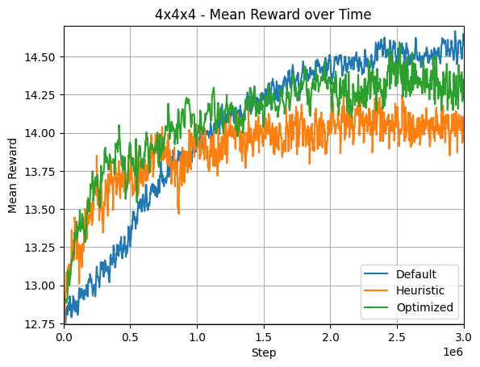
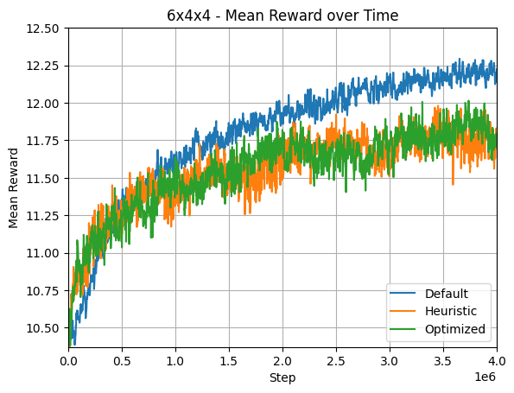
PPO-D
Default Hyperparameters
PPO-O
Optimized Hyperparameters
PPO-H
Restricted Action Space
Notes:
When looking at the larger container sizes, we can see that, despite the slower convergence rate, PPO-D eventually converges to a higher mean reward than the other agents. This suggests that a faster convergence rate does not necessarily lead to a better policy, and that the hyperparameters used for PPO-O and PPO-H are suboptimal for larger container sizes. Since these hyperparameters were tuned on a small container, it is possible that these hyperparameters are overfitted to the smaller container size, but this is purely speculative.

Slide 13
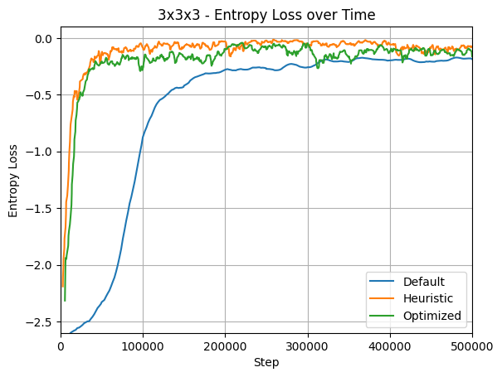
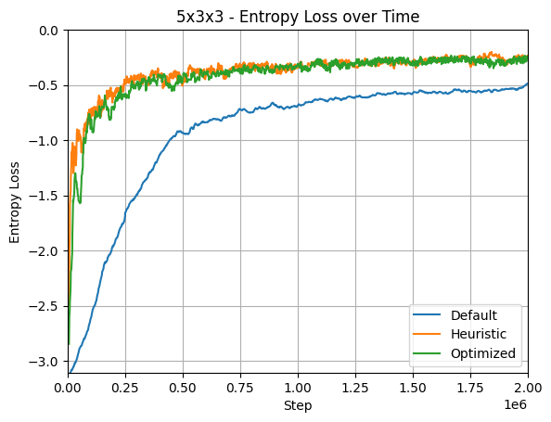
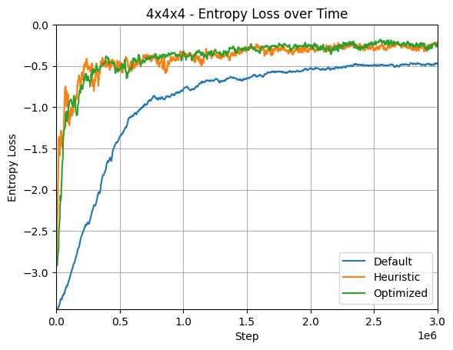
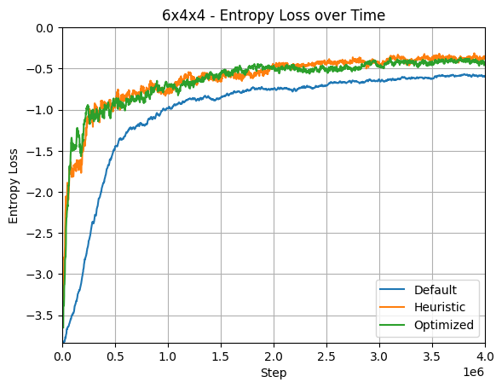
Notes:
Lastly, when we look at the entropy loss, we can see that the graph looks roughly the same for all container sizes. We can see that the entropy loss of PPO-D is consistently lower than that of the other agents, which suggests that it is less "confident" in its policy. This could either mean that PPO-D is able to learn a less exploitative policy than the other agents, or that the other agents are converging too quickly to local optima. But once again, this is purely speculative.

Slide 14
Experiment 2
Measuring Performance
Head-to-Head
10,000 Sequences
Number of Polycubes Packed
Time Taken
Notes:
The second experiment is related to the actual performance of the PPO agents. To evaluate this, all PPO agents were run head-to-head with the greedy agent on 10,000 polycube sequences, with the number of polycubes packed and the time taken to pack them recorded for each sequence.

Slide 15
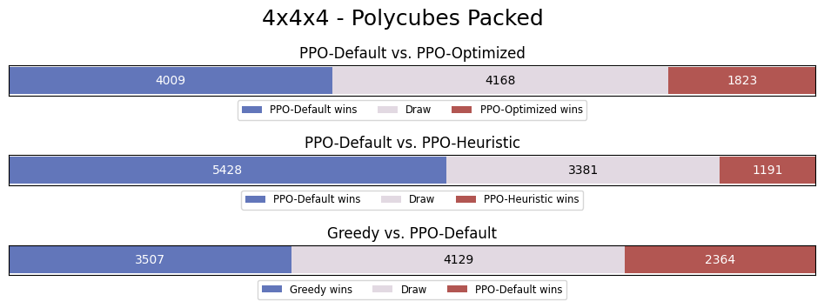
Notes:
I am only going to go through the results from the 4x4x4 container, but it should be noted that all other container sizes have roughly the same results as this one. The first two rows here are PPO-D head-to-head with PPO-O and PPO-H respectively, and you can see that PPO-D has indeed learned a better policy than the other agents, as it is able to outperform both of them. In the last row, we compare the performance of PPO-D with that of the greedy agent, and we see that the greedy agent is able to outperform PPO-D by a difference of about 1000 sequences. This means that, even though the PPO agents are able to solve the online polycube packing problem, they are not able to match the performance of the greedy agent.

Slide 16
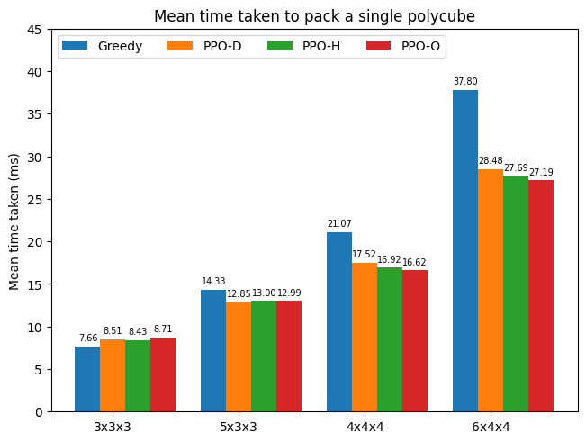
Notes:
The last set of results is related to the mean time taken to pack a single polycube. Here we can see that, especially for larger container sizes, all PPO agents are consistently faster than the greedy agent. This is as expected, as the heuristics have to do a lot more computations to find the optimal placement of the current polycube, whereas the PPO agents use a neural network that is very quick even for large container sizes.

Slide 17
Conclusion
Can online polycube packing be solved using deep reinforcement learning?
How does the performance of deep reinforcement learning compare to traditional heuristics?
Can the performance of deep reinforcement learning be improved by using heuristics to restrict the action space?
- Yes
- Faster, but not as good
- No
Notes:
To conclude, let's link these results back to the original research questions.
-- slide –-
The results show that deep reinforcement learning is a valid approach for solving the online polycube packing problem, but more research is needed to improve the overall performance. Deep reinforcement learning is consistently faster than the heuristics, but it is on average not able to pack as many polycubes. Finally, restricting the action space using heuristics does not seem to improve the performance of deep reinforcement learning in any meaningful way.

Slide 18
Limitations
Computational Cost
Larger Container Sizes
Hyperparameter Tuning
Notes:
As for the limitations of this research, I would say the main limitation is the computational cost associated with researching this problem. If I'd have to give a direction for future research, I would go that direction and suggest to repeat the experiments on larger container sizes or with more sophisticated hyperparameter tuning, to see if these results hold.

Slide 19
References:
P. Louridas, Real-World Algorithms (Title Slide)
H. Zhao et al., Online 3D Bin Packing with Constrained Deep Reinforcement Learning (Introduction – Polycube Packing)
H. Zhao et al., Learning Physically Realizable Skills for Online Packing of General 3D Shapes (Introduction – Polycube Packing)
Cmglee, Wikipedia: Polycube (Introduction – Polycube Packing)

Slide 20

Appendix

Slide 21
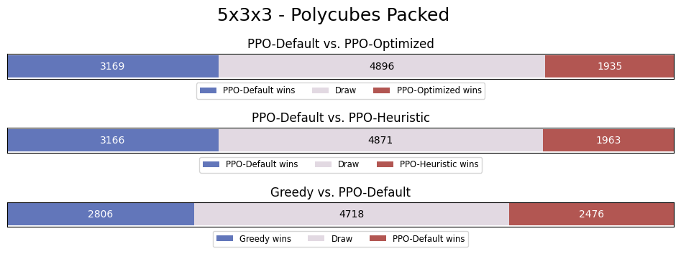
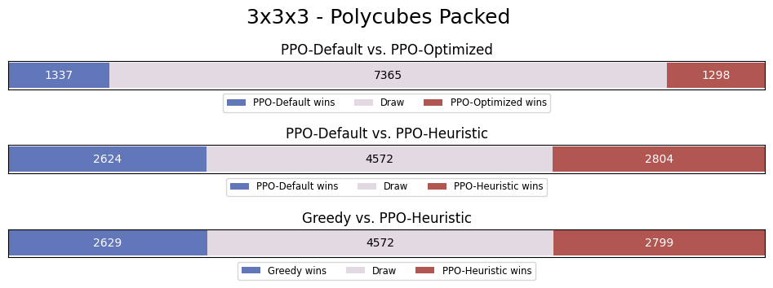
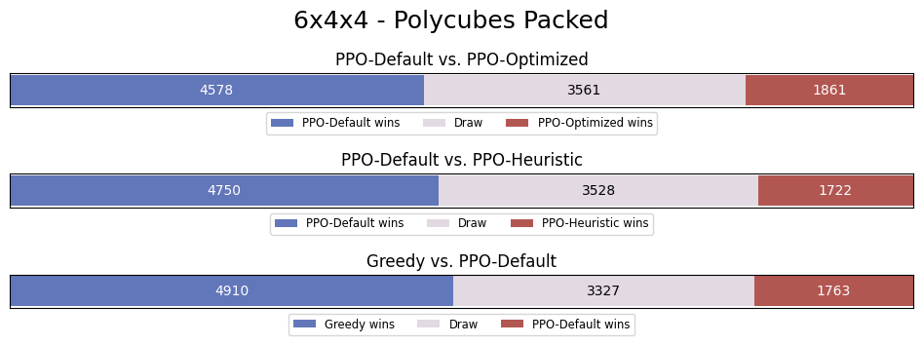

Slide 22
PPO Training Times
 | PPO-D | PPO-O | PPO-H
3x3x3 | 1.5 hr | 1.5 hr | 2 hr
5x3x3 | 8.5 hr | 6.5 hr | 12 hr
4x4x4 | 14 hr | 14 hr | 20 hr
6x4x4 | 32 hr | 32 hr | 45 hr

Slide 23
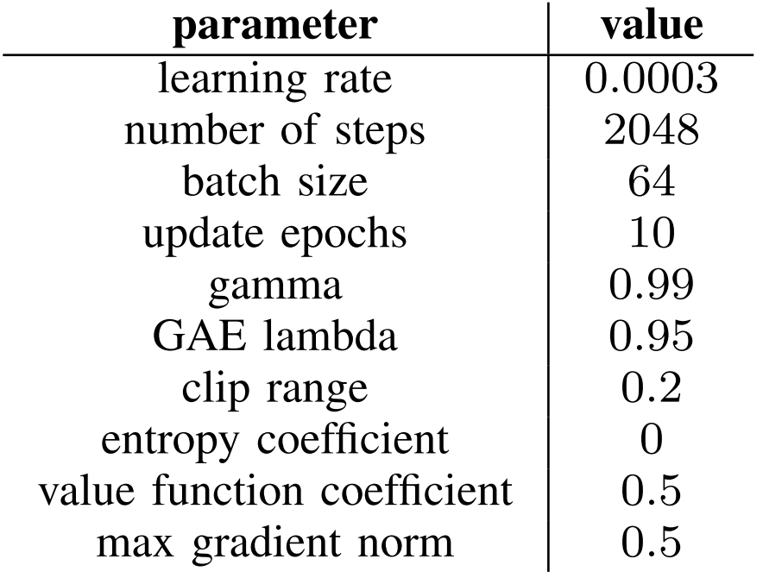
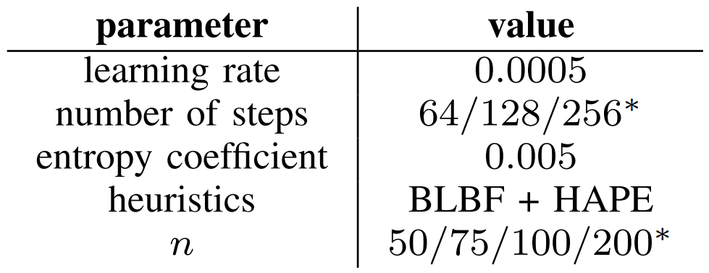
Default Hyperparameters
Optimized Hyperparameters

Slide 24
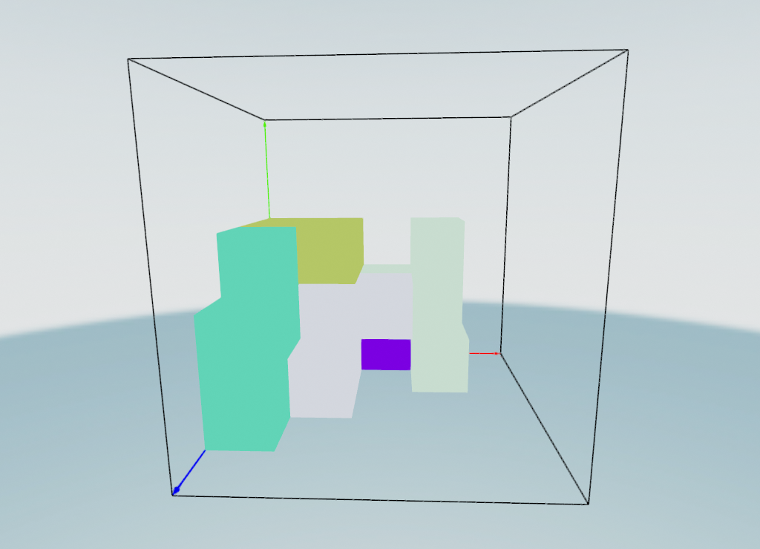
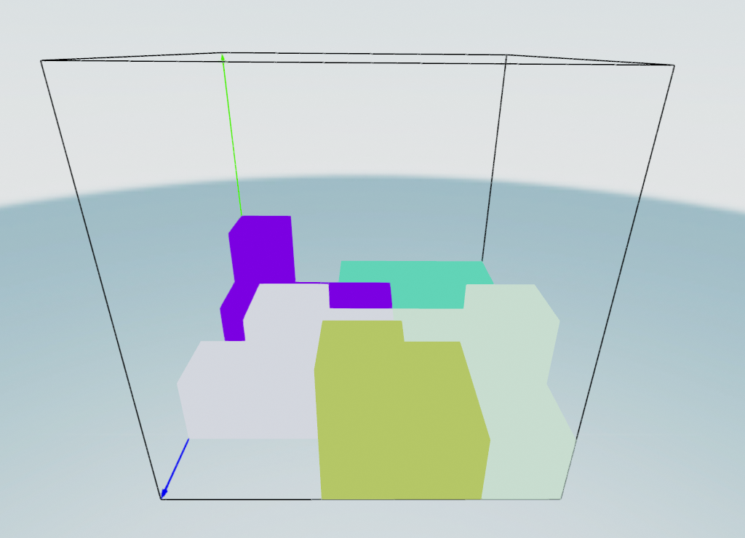
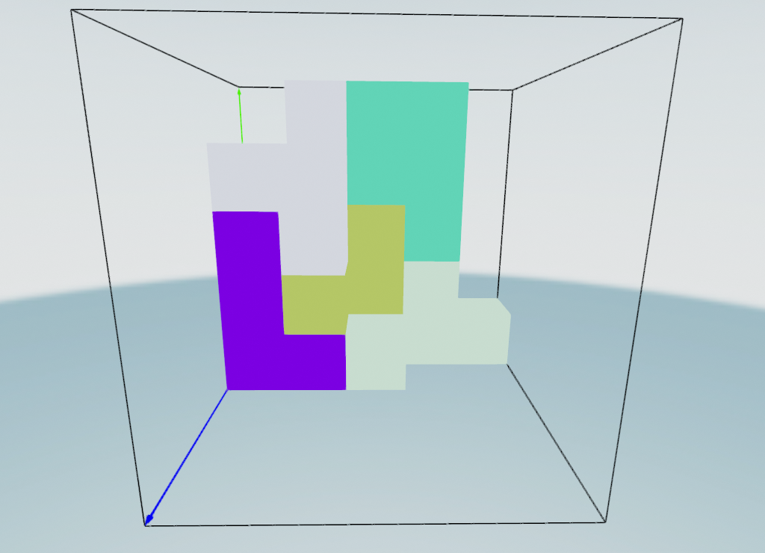
Heuristics
BLBF
HAPE
Heightmap Minimization

Slide 25
